Slide 1

DYNAMIC STRETCHING
PHYSICAL EDUCATION

Slide 2

LESSON OBJECTIVES:
THE IMPORTANCE OF DYNAMIC STRETCHING IN RELATION TO THE BODY AND PHYSICAL ACTIVITY.
IDENTIFYING THE MAJOR MUSCLES GROUPS AND THEIR RESPECTIVE LOCATIONS.
UNDERSTAND HOW THE MAJOR MUSCLES GROUPS ARE AFFECTED BY DYNAMIC STRETCHING.
IDENTIFY THE PHYSICAL COMPONENT THAT DYNAMIC STRETCHING IS RELATED TO.

Slide 3
WHAT MAJOR COMPONENT DOES DYNAMIC STRETCHING FALL UNDER IN PYHSICAL EDUCATION?
FLEXIBILITY

Slide 4


FLEXIBILITY
The ability of muscles and joints to move through a full range of motion.

Slide 5
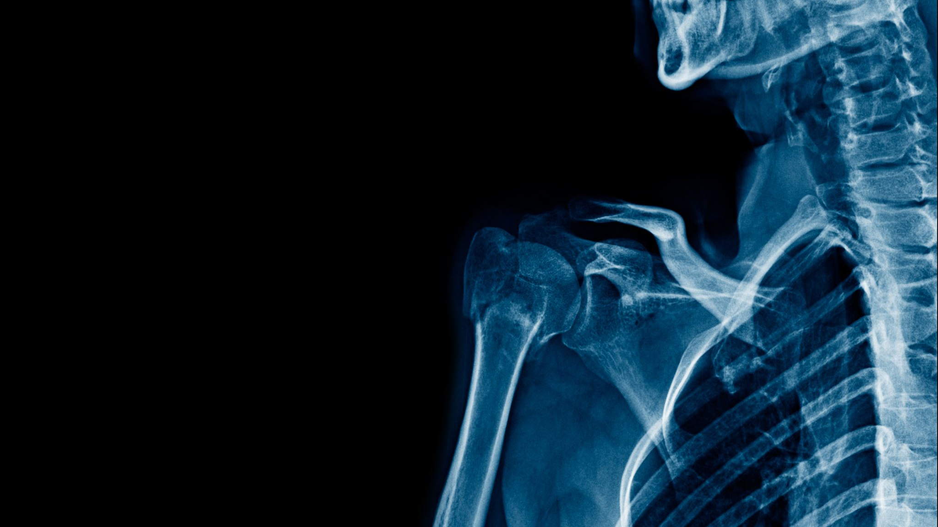
MAJOR MUSCLE RECAP

Slide 6
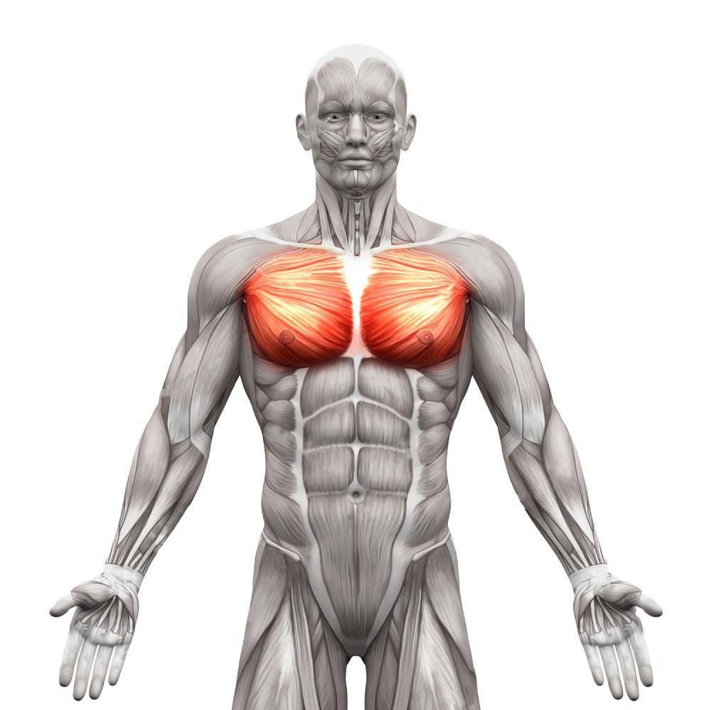
PECTORALIS

Slide 7
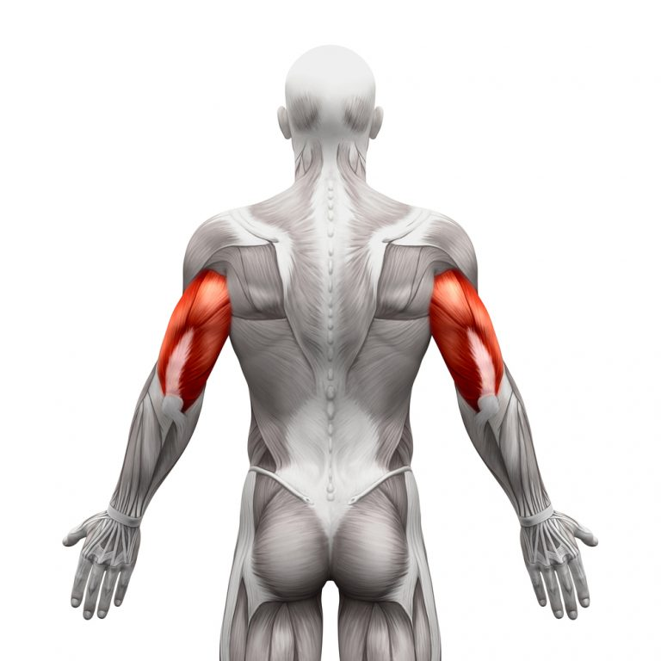
TRICEPS

Slide 8
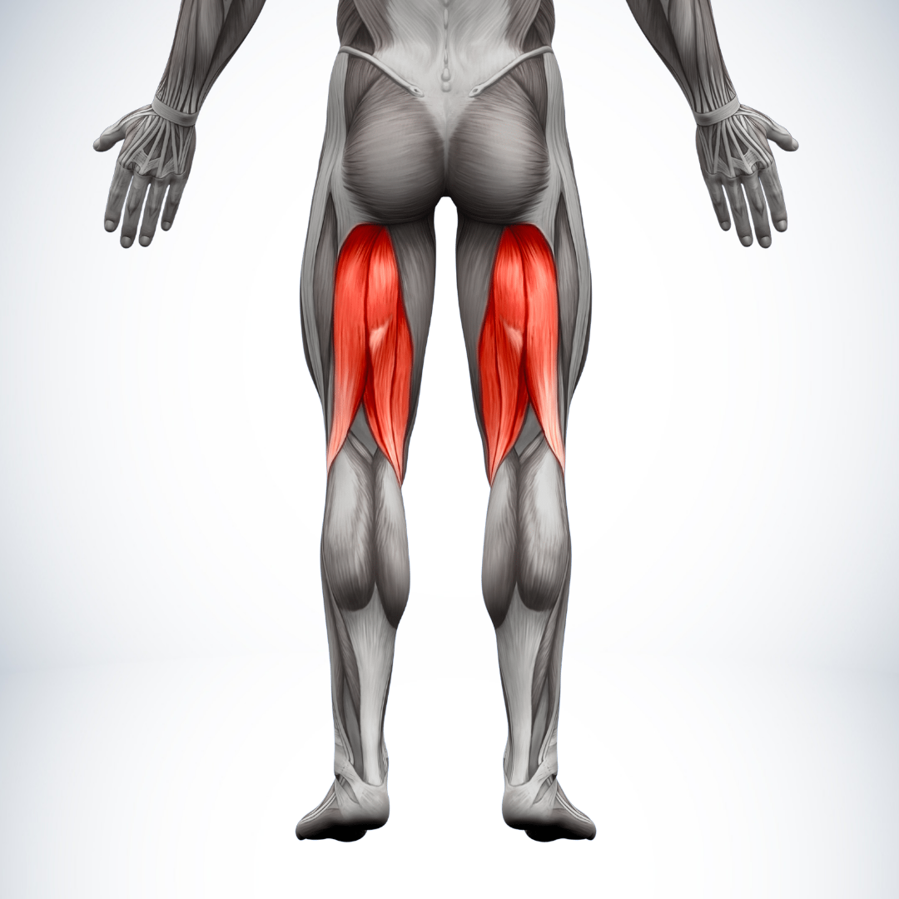
HAMSTRINGS

Slide 9
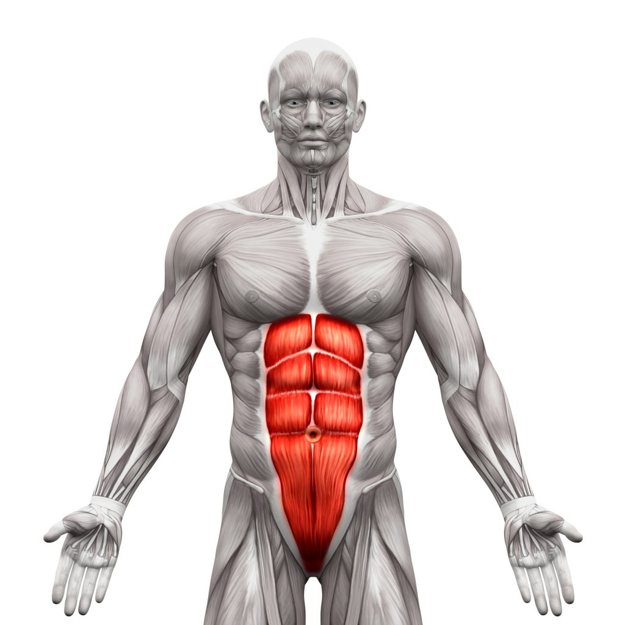
ABDOMINALS

Slide 10
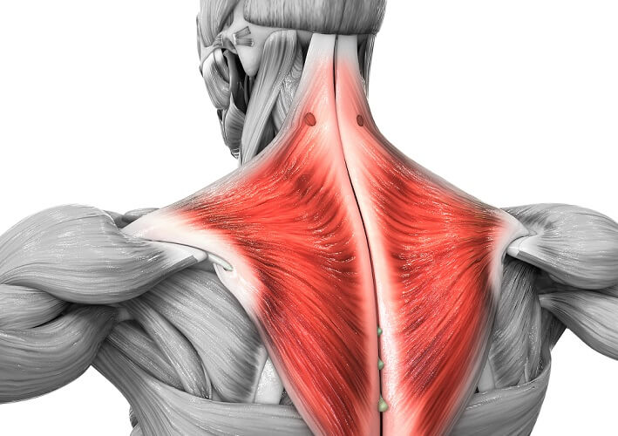
TRAPEZIUS/ TRAPS

Slide 11
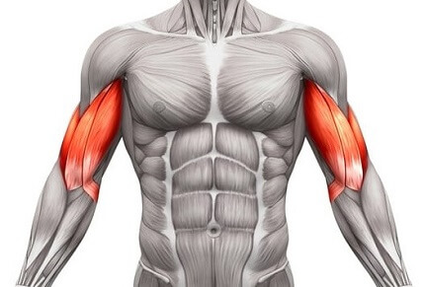
BICEPS

Slide 12
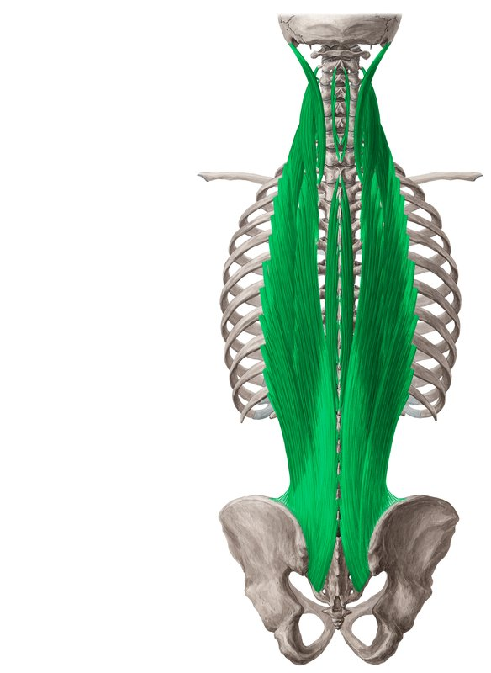
ERECTOR SPINAE

Slide 13
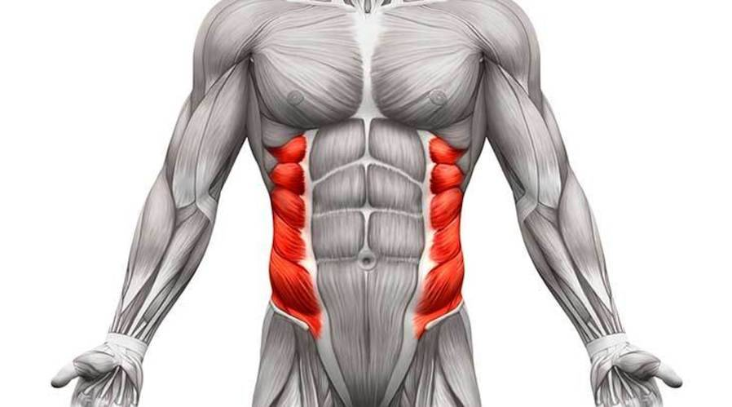
OBLIQUES

Slide 14
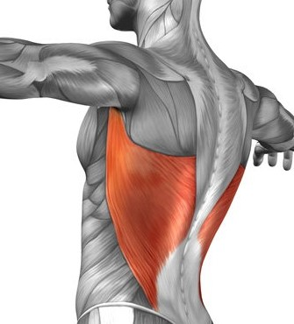
LATS

Slide 15
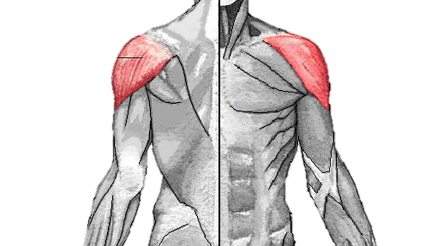
DELTOIDS

Slide 16
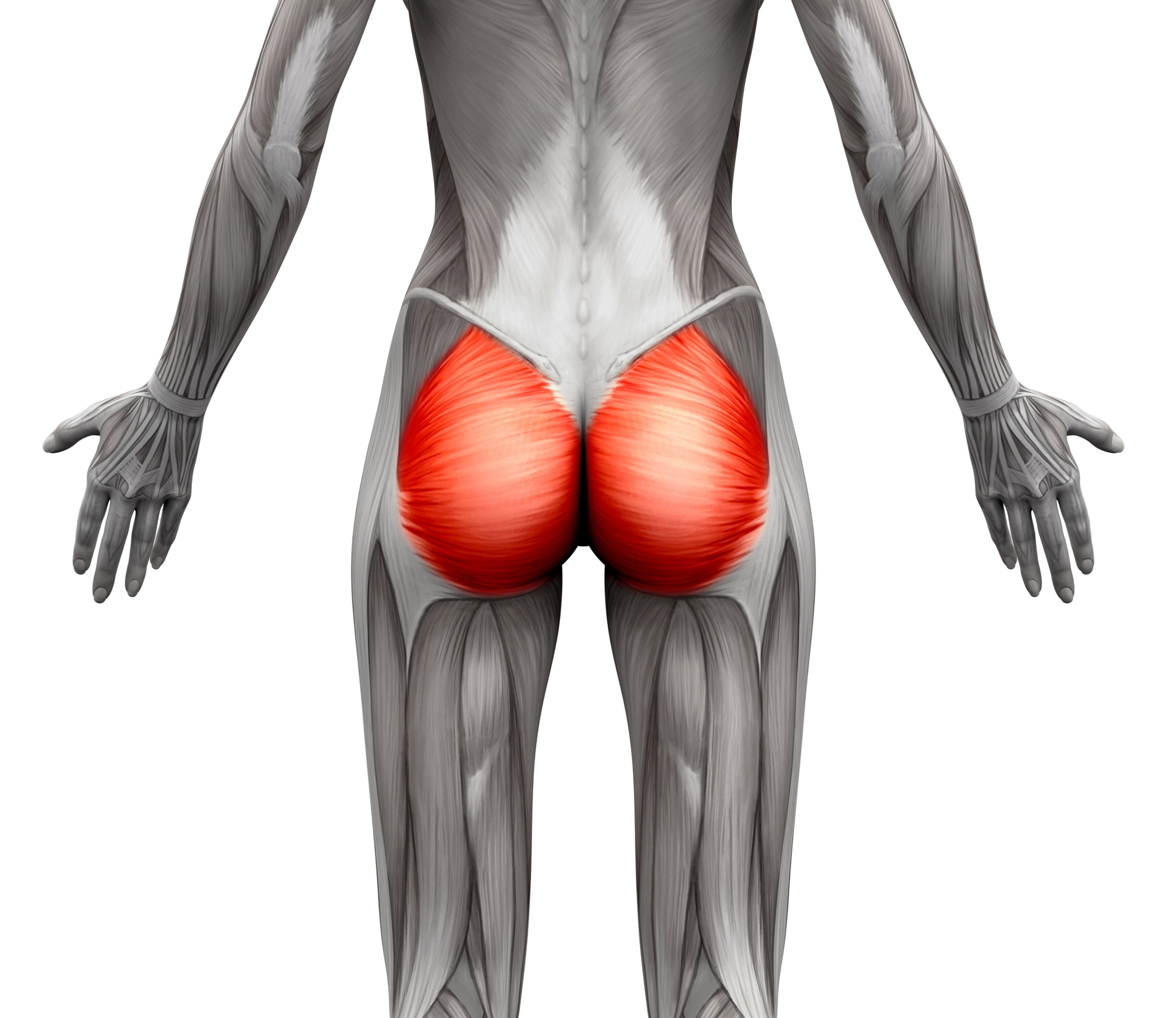
GLUTES

Slide 17
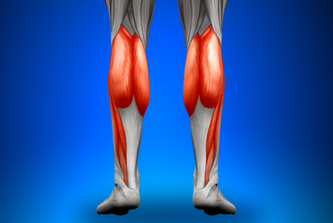
CALVES

Slide 18
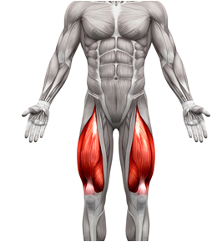
QUADRICEPS/ QUADS

Slide 19

DYNAMIC vs. STATIC STRETCHING
DYNAMIC STRETCHING INVOLVES ACTIVE MOVEMENT WHILE SIMULATNEOUSLY STRETCHING THE FOCUSED MUSCLE GROUP
STATIC STRETCHING INVOLVES HOLDING A STRETCH IN A STATIONARY POSITION
BOTH STRETCHING STYLES ARE COMPLEMENTARY TO THE PREPARATION AND RECOVERY OF PHYSICAL ACTIVITY

Slide 20
INTRODUCTION TO DYNAMIC STRETCHING
DYNAMIC STRETCHING IS A FORM OF STRETCHING THAT INVOLVES ACTIVELY MOVING YOUR MUSCLES AND JOINTS THROUGH A CONTROLLED RANGE OF MOTION. IT IS PERFORMED WITH FLUID AND CONTINUOUS MOVEMENTS, GENTLY INCREASING THE STRETCH WITH EACH REPETITION.
DYNAMIC STRETCHING IS COMMONLY USED AS PART OF A WARM-UP ROUTINE BEFORE PHYSICAL ACTIVITIES TO IMPROVE FLEXIBILITY, MOBILITY, AND CIRCULATION, WHILE ALSO PREPARING THE BODY FOR MORE INTENSE MOVEMENTS.
DYNAMIC STRETCHING FOCUSES ON DYNAMIC MOVEMENTS THAT MIMIC THE MOTIONS OF THE ACTIVITY TO FOLLOW.

Slide 21


Slide 22
WHY IS A PROPER WARM-UP IMPORTANT?
KNOWLEDGE RECAP
A. INCREASED BLOOD FLOW: WARMING UP GRADUALLY INCREASES HEART RATE, BLOOD FLOW, AND CIRCULATION. THIS HELPS DELIVER OXYGEN AND NUTRIENTS TO MUSCLES, PREPARING THEM FOR THE INCREASED DEMAND THAT EXERCISE PLACES ON THEM.
B. IMPROVED MUSCLE FUNCTION: A WARM-UP HELPS INCREASE MUSCLE TEMPERATURE, MAKING MUSCLES MORE PLIABLE AND RESPONSIVE. THIS ENHANCES MUSCLE CONTRACTILITY AND REDUCES THE RISK OF MUSCLE STRAINS.
C. ENHANCED NERVE FUNCTION: A WARM-UP ALSO IMPROVES NERVE FUNCTION AND RESPONSIVENESS. THIS IS IMPORTANT FOR THE COORDINATION AND TIMING OF MUSCLE CONTRACTIONS, LEADING TO BETTER MOTOR CONTROL AND PERFORMANCE.
D. MENTAL PREPARATION: WARMING UP MENTALLY PREPARES INDIVIDUALS FOR EXERCISE. IT HELPS SHIFT FOCUS FROM DAILY TASKS TO THE UPCOMING PHYSICAL ACTIVITY, ENHANCING CONCENTRATION AND READINESS TO PERFORM.
E. INJURY PREVENTION: A PROPER WARM-UP GRADUALLY PREPARES THE BODY FOR MORE INTENSE ACTIVITY, REDUCING THE RISK OF SUDDEN, JARRING MOVEMENTS THAT COULD LEAD TO INJURY. IT HELPS PREPARE JOINTS, LIGAMENTS, AND TENDONS FOR THE STRESS OF EXERCISE.
Notes:
Have students answer slide title question before revealing the answers.

Slide 23
IMPORTANCE OF DYNAMIC STRETCHING
IMPROVED BLOOD CIRCULATION: Dynamic stretching increases blood flow to the muscles and tissues. This enhanced circulation delivers more oxygen and nutrients to the muscles, making them more pliable and ready for action.
ENHANCED RANGE OF MOTION (ROM): Dynamic stretching helps improve joint flexibility and range of motion. By moving joints through their full range in a controlled manner, it helps increase the length and flexibility of muscles and connective tissues.
INCREASED MUSCLE TEMPERATURE: Active movements during dynamic stretching raise muscle temperature. Warmer muscles are more elastic and less prone to injury, allowing them to stretch further and more comfortably.
NEUROMUSCULAR ACTIVATION: Dynamic stretching stimulates the nervous system, sending signals to the muscles to be ready for movement. This activation enhances muscle coordination and responsiveness, leading to better performance.
PREVENTION OF INJURY: A proper dynamic stretching routine primes muscles and tendons to handle the demands of physical activity. This reduces the risk of muscle strains, tears, and other injuries that can occur when muscles are not adequately prepared.
MUSCLE COORDINATION: Dynamic stretching involves multiple muscle groups working together in a coordinated manner. This helps improve overall movement patterns and coordination, which is particularly important for activities requiring agility and quick direction changes.
ELEVATED HEART RATE: Dynamic stretching gradually increases the heart rate, contributing to the overall warm-up process. This cardiovascular effect prepares the cardiovascular system for the demands of exercise.
MENTAL PREPARATION: Engaging in dynamic stretching also helps mentally prepare for physical activity. It shifts your focus to the task at hand and helps create a mind-muscle connection, enhancing performance.

Slide 24
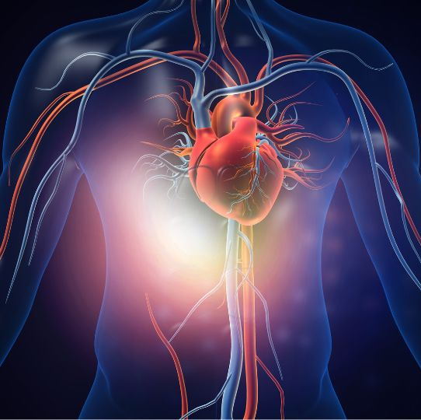
WHAT IS THE YELLOW ARROW POINTING TO?
WHAT MAJOR PHYSICAL COMPONENT IS THIS MUSCLE IS CONNECTED TO?
A. CARDIOVASCULAR
B. MUSCULAR STRENGTH
C. MUSCULAR ENDURANCE
D. BODY COMPOSITION
E. FLEXIBILITY

Slide 25

INCORPORATING DYNAMIC STRETCHES
WHEN TO INCORPORATE:
AS A PRE-WORKOUT ROUTINE
PRIOR TO STRENGTH TRAINING
IDEAL FOR SPORTS PREPARATION
BEFORE CARDIOVASCULAR EXERCISE
CAN YOU NAME 3 CARDIOVASCULAR EXERCISES?

Slide 26
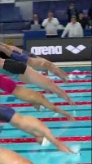



Slide 27

CAN YOU NAME SOME ATHLETES THAT INCORPORATE DYNAMIC STRETCHING BEFORE THEIR GAMES?

Slide 28

DYNAMIC STRETCHING MYTHS
DOES NOT DECREASE STRENGTH
DOES NOT CAUSE MUSCLE TIGHTNESS
DOES NOT REPLACE WARM-UP
Notes:
Teacher emphasizes the importance of this slide.

Slide 29
TYPES OF DYNAMIC STRETCHES
LEG SWINGS (FRONT/BACK, SIDE-TO-SIDE)
ARM CIRCLES
HIP ROTATIONS
TORSO TWISTS
WALKING LUNGES WITH ROTATION
HIGH KNEES
CAN YOU LIST ANY NOT NAMED ON THIS LIST?

Slide 30
DOES DYANMIC STRETCHING ENHANCE PERFORMANCE AND FLEXIBILITY?
YES.
ENHANCED PERFORMANCE:
INCREASED MUSCLE ACTIVATION
Dynamic stretching activates the muscles and nervous system, which leads to improved muscle responsiveness. This heightened activation translates to better muscular contraction and coordination during physical activities, resulting in more efficient and powerful movements.
IMPROVED BLOOD FLOW
The dynamic movements involved in dynamic stretching increase blood circulation to the muscles. This helps supply more oxygen and nutrients to the muscles, enhancing their ability to perform optimally during exercise.
OPTIMIZED RANGE OF MOTION
Dynamic stretching promotes a full range of motion in joints and muscles. This increased range allows for a greater degree of movement during exercise, leading to more dynamic and efficient motions.
ENHANCED NEUROMUSCULAR COMMUNICATION
Dynamic stretching improves the communication between the nervous system and muscles. This improved connection enhances proprioception and overall body awareness, leading to better control over movements and improved balance.
ENHANCED FLEXIBILITY:
IMPROVED MUSCLE ELASTICITY
Dynamic stretching involves rhythmic, controlled movements that gradually increase muscle length. This contributes to improved muscle elasticity, allowing muscles to stretch and contract more effectively.
INCREASED JOINT FLEXIBILITY
By moving joints through their full range of motion, dynamic stretching helps improve joint mobility. This can help prevent stiffness and maintain joint health over time.
MUSCLE FIBER ALIGNMENT
Dynamic stretching encourages muscle fibers to align more efficiently along the lines of force. This alignment contributes to better muscle function, less resistance during movement, and reduced risk of injury.
REDUCED MUSCLE TENSION
Regular dynamic stretching can help reduce muscle tension and tightness. This can lead to greater comfort during movement and decreased chances of muscle strains or pulls.

Slide 31
SAFETY AND GUIDELINES: (DYNAMIC STRETCHING)
WARM UP BEFORE DYNAMIC STRETCHING.
AVOID BOUNCING OR JERKING MOVEMENTS DURING STRETCHING.
BREATH DEEPLY AND CONSISTENTLY DURING STRETCHES.
LISTENING TO YOUR BODY AND AVOID EXCESSIVE DISCOMFORT OR PAIN.
START SLOWLY, INCREASE INTENSITY GRADUALLY
AVOID OVERSTRETCHING
CONSULT A PROFESSIONAL IF IN DOUBT
STRETCHING SHOULD NOT BE PAINFUL.
Notes:
Teacher emphasizes the importance of this slide.

